Slide 1
Healthcare Management Organisation (HMO)
GROUP 5
Bhavya Shah
Sharvari Khairnar
Tejas Amrutkar
Khushi Shetty
Samriddhi Tiwari

Slide 2
Background
The case's primary goal is to provide practical insight since it is becoming more and more important to accurately estimate which individuals (clients) will be pricey utilizing the available data.
In order to compare which area of the health sector is more expensive than others in general health care, a number of aspects must be looked into.
We've examined the key factors that influence consumer decisions to use hospitals more frequently or pay for their services.

Slide 3
Phases in Analysis
1
2
3
4
Understanding the data and loading it with relevant libraries
.
Cleaning and exploring data with statistical approaches and visualization
To create various prediction models and compare the model results in order to select the best model
Conclusion and
Actionable Insights

Slide 4
Variables in the dataset
Age
Location
Location Type
Physically Active
Smoker
BMI
Hypertension
Gender
Yearly Physical
Education Level
Married
Number of Children
Cost

Slide 5
Overview
The primary objective of this project is to pinpoint the distinct factors that cause certain individuals to incur higher healthcare expenses than others, anticipate which individuals will have higher healthcare costs in the coming year, and offer practical recommendations to the HMO on how to decrease their healthcare expenses.

Slide 6
Initial Analysis
Dataset consists 7582 rows (people) with 14 columns (factors).
For data cleaning, we removed NA values from bmi and hypertension variables by interpolation.
Based on cost, the variable "expensive" was defined. If the cost exceeds 75% of the total cost frequency, it is termed expensive, while the rest is considered inexpensive.
Data partition: Training data - 80% and testing data 20%

Slide 7
Understanding the reasons for expensive health care

Slide 8
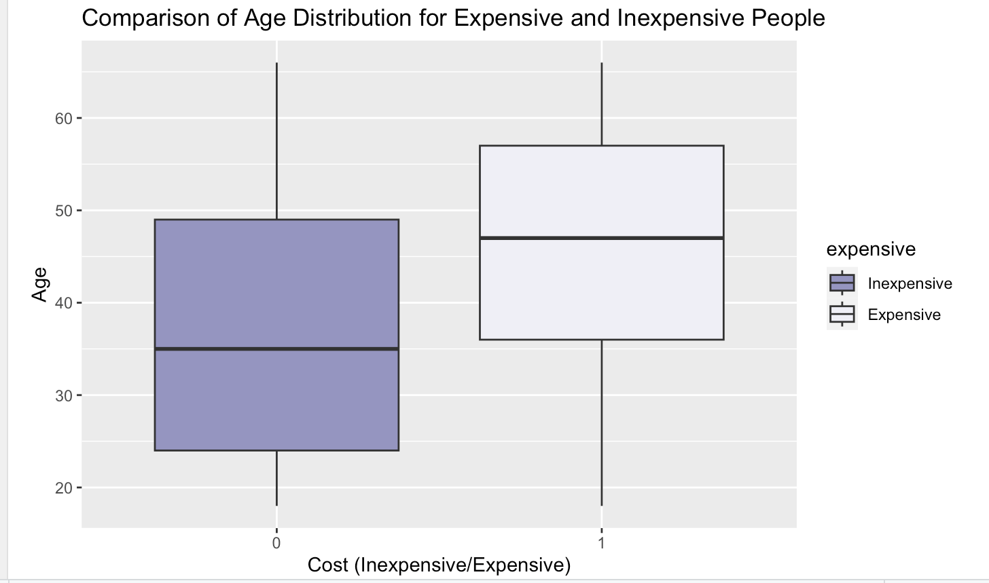
Boxplot for Healthcare Cost by Age
Notes:
Cost by Age is greater for exp people as compared to normal people as the median for exp people is approx 47 while for normal people it is 35.

Slide 9
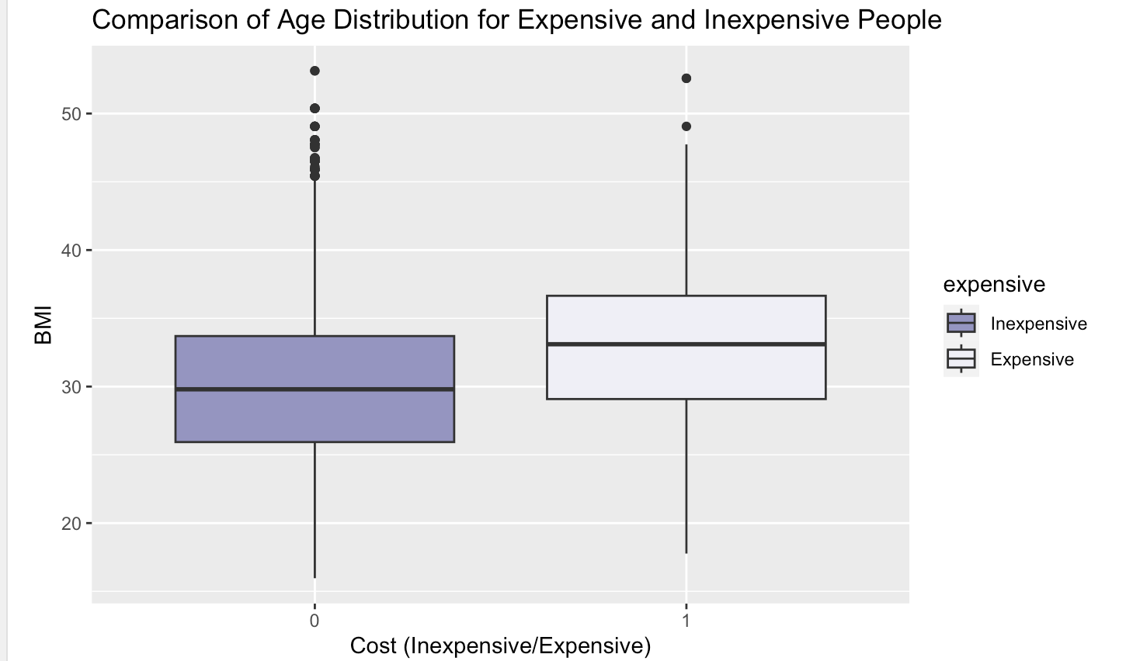
Boxplot for Healthcare Cost by BMI
Notes:
Similarly, the cost by bmi for exp people is greater than normal , but the cost by bmi for inexpensive people is same as normal as their medians are similar.

Slide 10
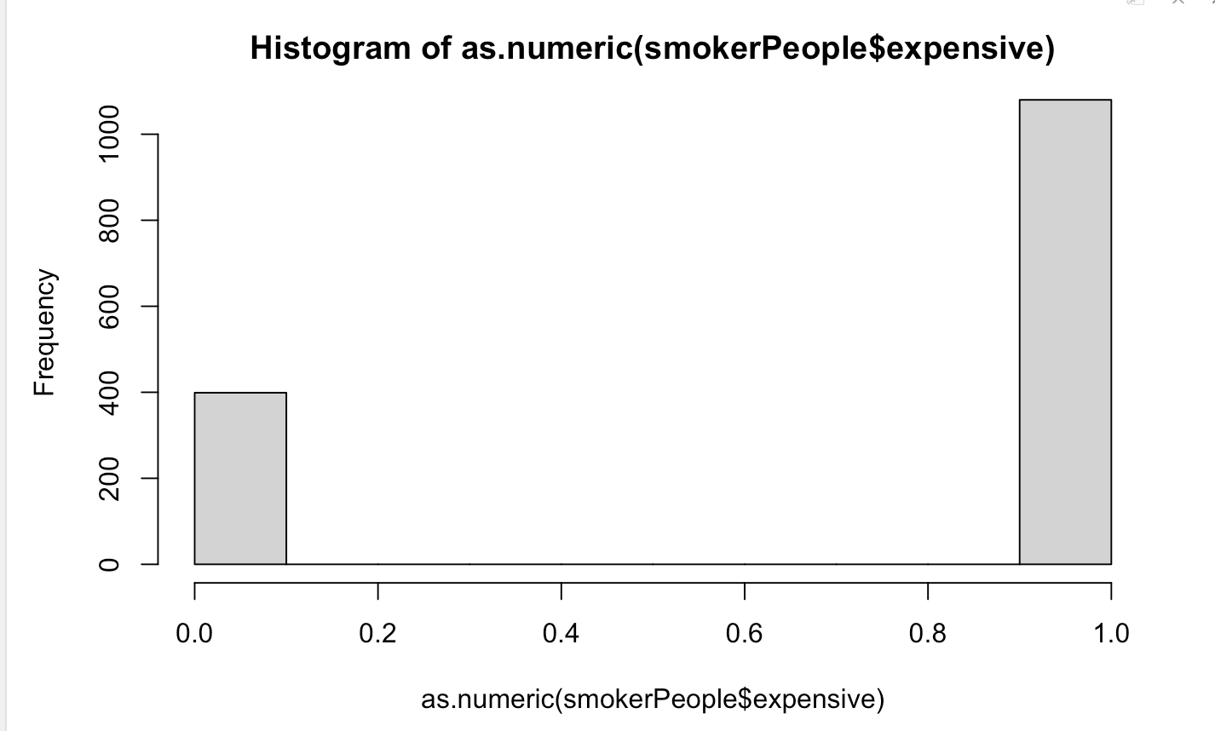
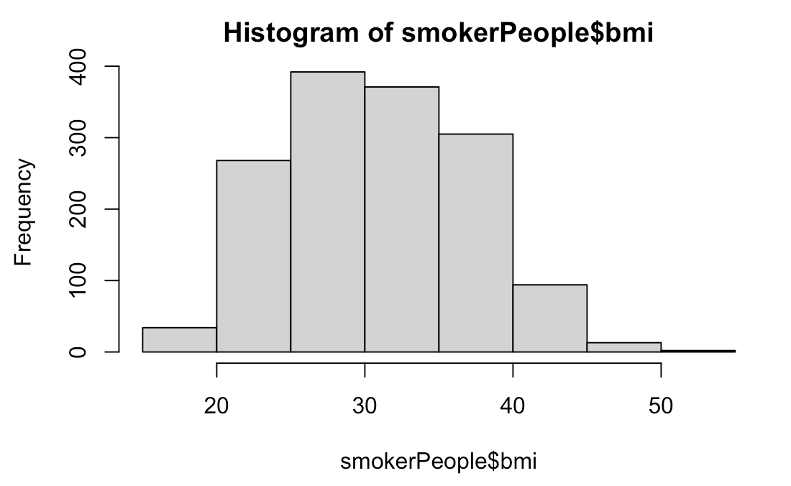
Smoker data analysis
Smoker Vs Expensive People
Smoker Vs BMI
Notes:
The histograms displays frequency of smokers based on expensiveness and bmi.
1)The left graph shows that most expensive people are smokers and has a frequency of 1000
2)The average BMI of a person is normally in the range 18-25, but as we can see in the right graph, majority people who smoke has a BMI of the range 25-30, thus their health is affected, thus expense increases

Slide 11
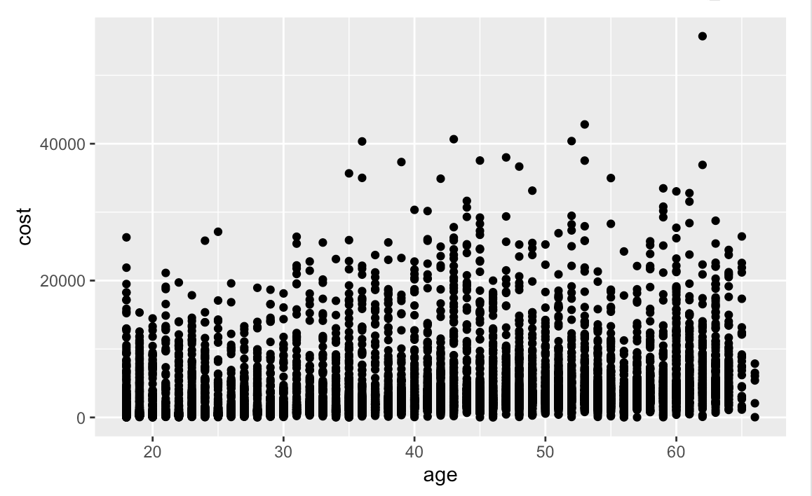
Scatterplot for Age VS Cost
From the below Scatterplot for Age Vs Cost, we can see that it is highly populated from 0 to 10000 USD from 18 to 65 years old
Notes:
For all age group, cost is 0-20000$

Slide 12
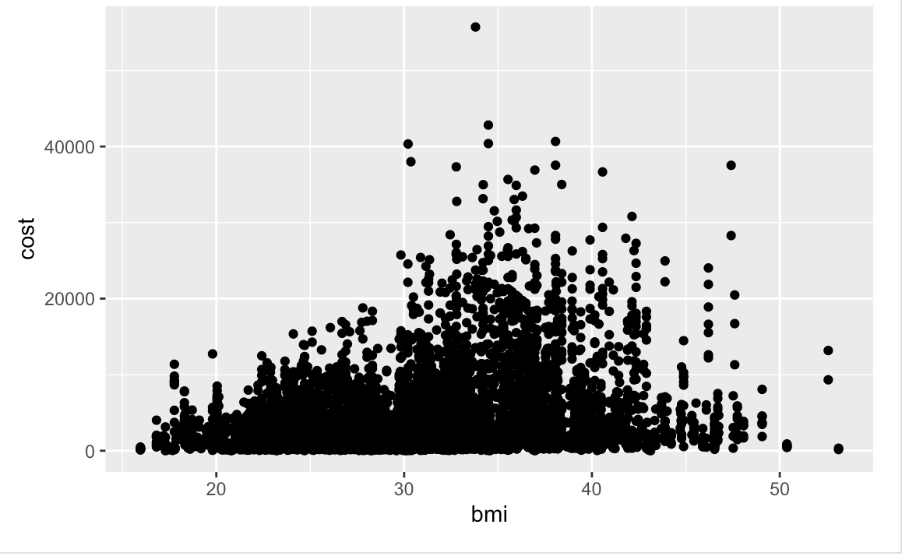
Scatterplot for BMI vs COST
From the below scatter plot for BMI Vs Cost, we can see that the frequency of the graph is highly populated from 16 to 35 BMI and cost ranges from 0 to 10000 USD
Notes:
Cost is majorly between the bmi 30-40

Slide 13
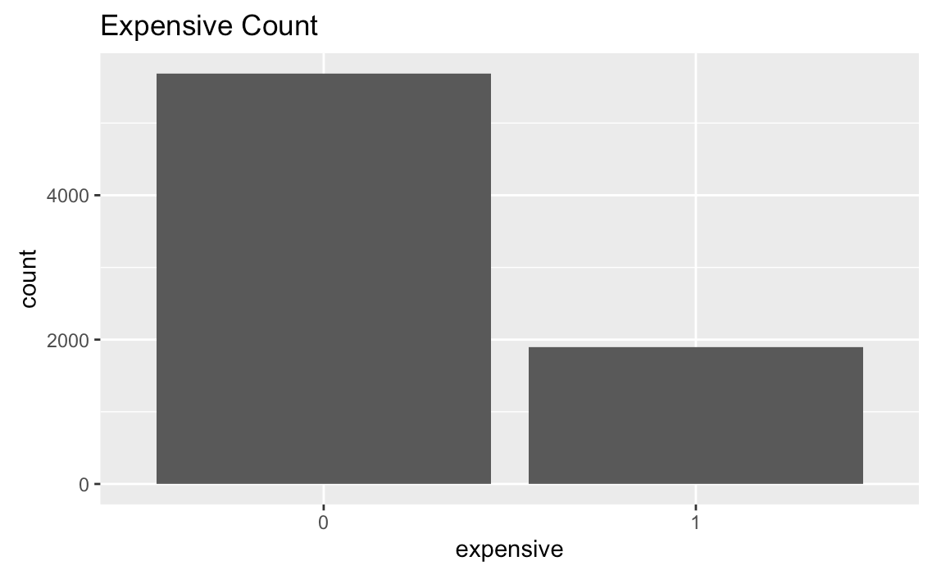
Barplot for expensive count
From the below bar plot, we can observe the number of expensive people count is around 1980

Slide 14
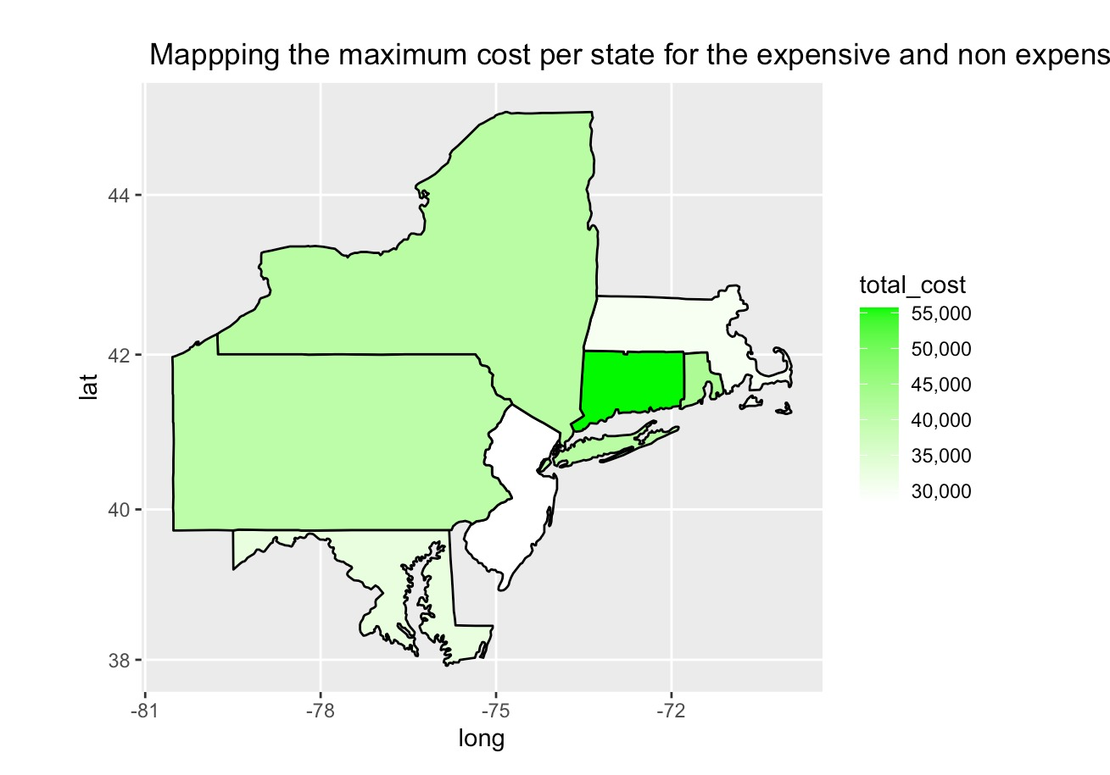
Mapping the expensive and inexpensive people on the basis of maximum cost spent on healthcare per state
Notes:
Next, this maps shows out where healthcare has been utilised max, that is the maximum cost per state for expensive and non expensive people. Based on the map, we can see that the Highest cost is in CT(Connecticut), with a frequency of 55,000$

Slide 15
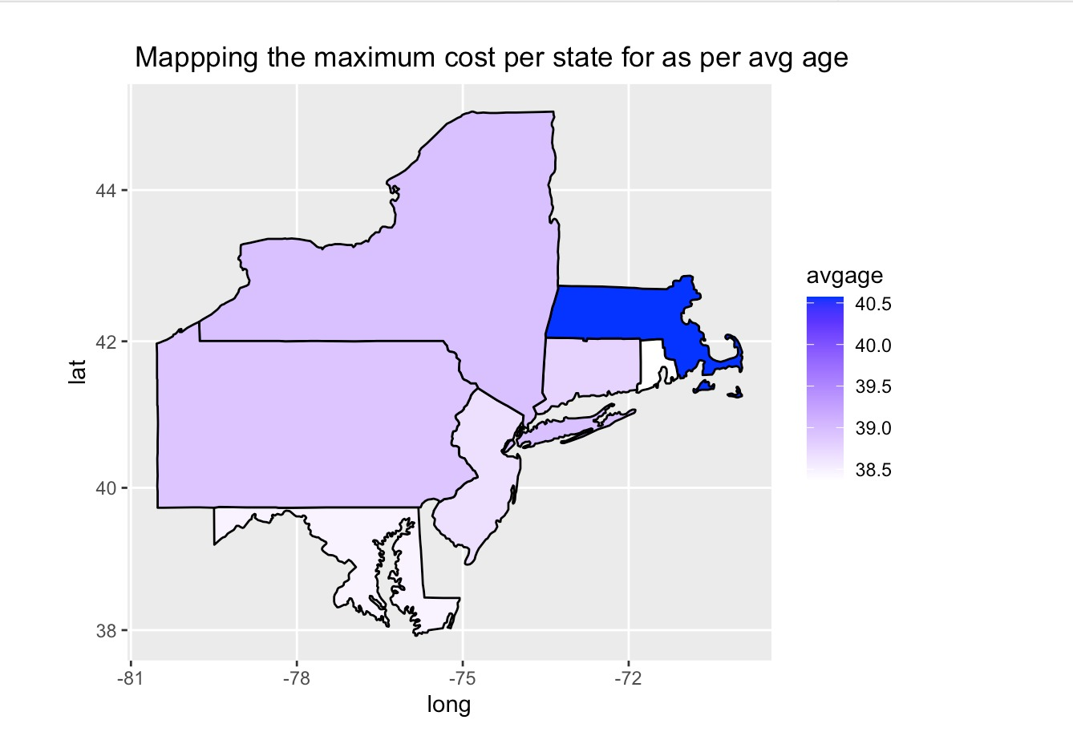
Mapping the age per state for the expensive and inexpensive people on the basis of average age of people
Notes:
Later, we calculated the average age of people using healthcare and their location, based on the map, the Avg age is found in MA(Massachusetts) with a frequency of 40.5

Slide 16
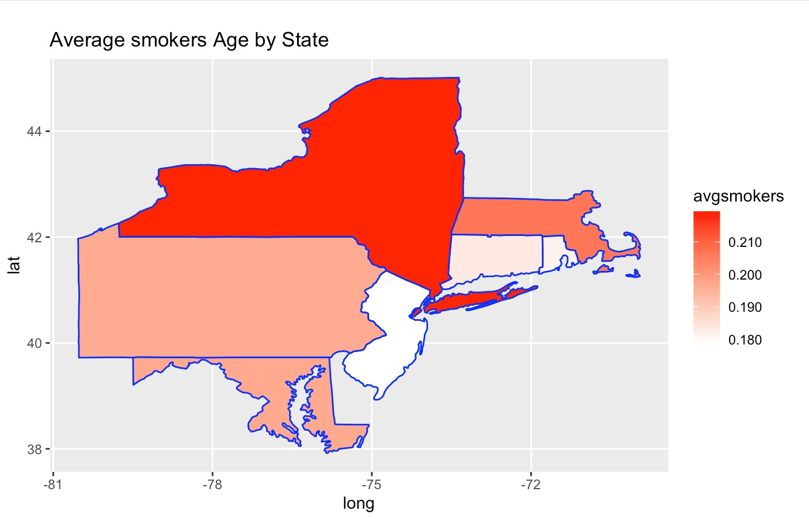
Mapping the average smokers per state
Notes:
Lastly, we mapped out to find the average number of smokers in the states, and based on the analysis NY has the avg smokers with a frequency of 0.210

Slide 17
Deciding our Best Model
Support Vector Machine (SVM)
Accuracy: 87.60%
Sensitivity: 97.54%
Tree Model
Accuracy: 87.34%
Sensitivity : 97.80%
Linear Model
Accuracy: 42.33%

Slide 18
Recommendations
If we already charge older people with higher premiums due to their age, we don't need to charge more for someone with a high BMI. This is the case because aging has a greater impact on BMI than smoking does.
35%
Smokers ought to pay more in premiums. Relative to non-smokers, smokers spend much more on healthcare, therefore charging a higher premium to smokers would help offset the high cost of healthcare.
If you smoke in New York, the premium needs to be substantially greater. Only New York had healthcare prices that were much higher than those in other states.

Slide 19
Conclusion
We were able to determine the causes of expensive health care from the analysis done on the provided data set, as well as the reasons why some people pay more for healthcare services.
This project made it easier to comprehend how to make expensive people understand the importance of adopting healthy habits as well as how to lower healthcare costs.

Slide 20
Thank You!

